Slide 1
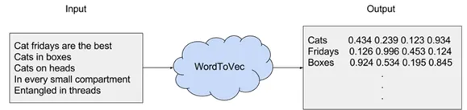
Word2Vec
Word2Vec is one of the emerging and prominent word embedding technique.
Proposed by Mikolov et al. in 2013.
Word2vec is a combination of models used to represent distributed representations of words in a corpus C.
Word2Vec (W2V) is an algorithm that accepts text corpus as an input and outputs a vector representation for each word, as shown in the diagram below:

Slide 2
There are two flavors of this algorithm
CBOW
it uses each of these contexts to predict the current word w, in that case the method is called “Continuous Bag Of Words” (CBOW).
To limit the number of words in each context, a parameter called “window size” is used.
Skip-Gram
Given a set of sentences (also called corpus) the model loops on the words of each sentence and either tries to use the current word w in order to predict its neighbors (i.e., its context).

Slide 3
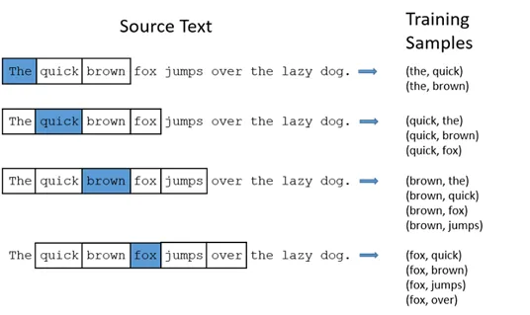

Slide 4
Vector Representation
The vectors we use to represent words are called neural word embeddings, and representations are strange.
One thing describes another, even though those two things are radically different.
Word2vec “vectorizes” about words, and by doing so it makes natural language computer-readable — we can start to perform powerful mathematical operations on words to detect their similarities.

Slide 5
Word2vec is similar to an autoencoder
So, a neural word embedding represents a word with numbers.
It’s a simple, yet unlikely, translation.
Word2vec is similar to an autoencoder, encoding each word in a vector, but rather than training against the input words through reconstruction, as a restricted Boltzmann machine does, word2vec trains words against other words that neighbor them in the input corpus.

Slide 6
It does so in one of two ways
either using context to predict a target word (a method known as continuous bag of words, or CBOW)
or using a word to predict a target context, which is called skip-gram. We use the latter method because it produces more accurate results on large datasets.

Slide 7
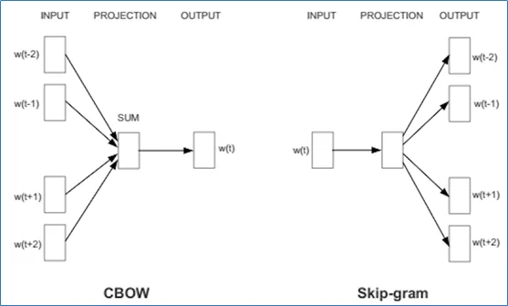
In this lecture, we are going to focus on Skip-Gram model which in contrast to CBOW consider center word as input as depicted in figure above and predict context words.

Slide 8
The components of the vector are adjusted
When the feature vector assigned to a word cannot be used to accurately predict that word’s context, the components of the vector are adjusted.
Each word’s context in the corpus is the teacher sending error signals back to adjust the feature vector.
The vectors of words judged similar by their context are nudged closer together by adjusting the numbers in the vector.

Slide 9
Model overview
We have to feed some strange neural network with some pairs of words but we can’t just do that using as inputs the actual characters, we have to find some way to represent these words mathematically so that the network can process them.
One way to do this is to create a vocabulary of all the words in our text and then to encode our word as a vector of the same dimensions of our vocabulary.
Each dimension can be thought as a word in our vocabulary.
So, we will have a vector with all zeros and a 1 which represents the corresponding word in the vocabulary.
This encoding technique is called one-hot encoding.

Slide 10
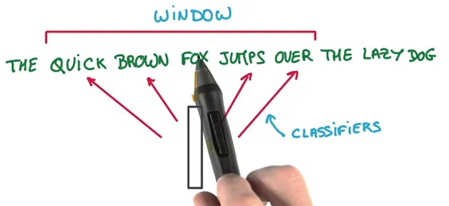
Example:
Considering our example, if we have a vocabulary made out of the words “the”, “quick”, “brown”, “fox”, “jumps”, “over”, “the” “lazy”, “dog”, the word “brown” is represented by this vector: [ 0, 0, 1, 0, 0, 0 ,0 ,0 ,0 ].
The Skip-gram model takes in a corpus of text and creates a hot-vector for each word.

Slide 11

Hot Vector
A hot vector is a vector representation of a word where the vector is the size of the vocabulary (total unique words).
All dimensions are set to 0 except the dimension representing the word that is used as an input at that point in time.
Here is an example of a hot vector:
The above input is given to a neural network with a single hidden layer.

Slide 12
Cont’d
We’re going to represent an input word like “ants” as a one-hot vector.
This vector will have 10,000 components (one for every word in our vocabulary) and we’ll place a “1” in the position corresponding to the word “ants”, and 0s in all of the other positions.
The output of the network is a single vector (also with 10,000 components) containing, for every word in our vocabulary, the probability that a randomly selected nearby word is that vocabulary word.

Slide 13
In word2vec, a distributed representation of a word is used
Take a vector with several hundred dimensions (say 1000).
Each word is represented by a distribution of weights across those elements.
So instead of a one-to-one mapping between an element in the vector and a word, the representation of a word is spread across all the elements in the vector, and each element in the vector contributes to the definition of many words.

Slide 14
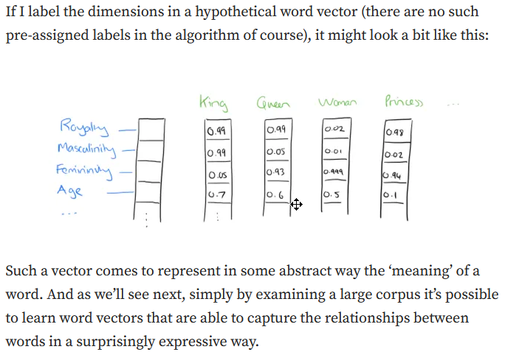

Slide 15
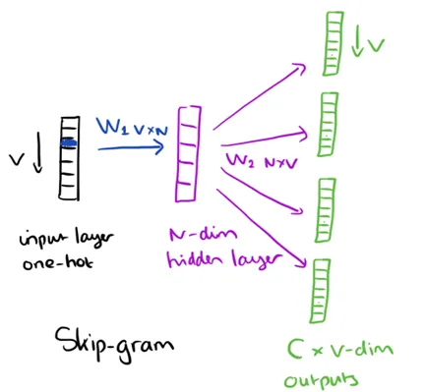
We can also use the vectors as inputs to a neural network
Since our input vectors are one-hot, multiplying an input vector by the weight matrix W1 amounts to simply selecting a row from W1.

Slide 16
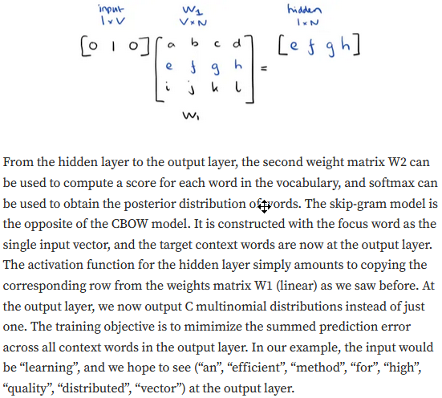

Slide 17
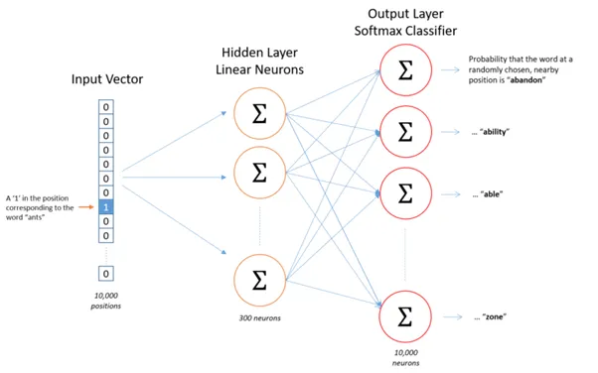
Here’s the architecture of our neural network

Slide 18
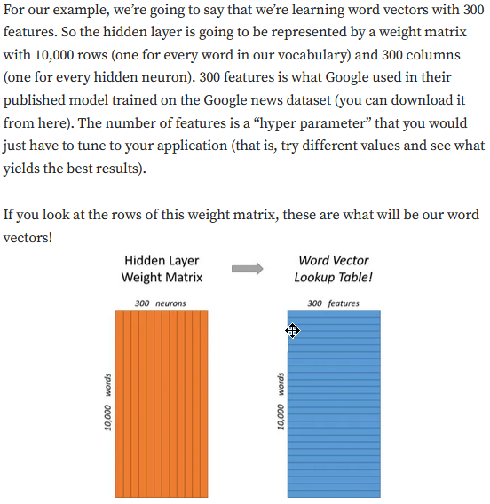

Slide 19
Hidden layer weight matrix
So, the end goal of all of this is really just to learn this hidden layer weight matrix — the output layer we’ll just toss when we’re done!
The 1 x 300 word vector for “ants” then gets fed to the output layer.
The output layer is a Softmax Regression classifier.
Specifically, each output neuron has a weight vector which it multiplies against the word vector from the hidden layer, then it applies the function exp(x) to the result.
Finally, in order to get the outputs to sum up to 1, we divide this result by the sum of the results from all 10,000 output nodes.

Slide 20
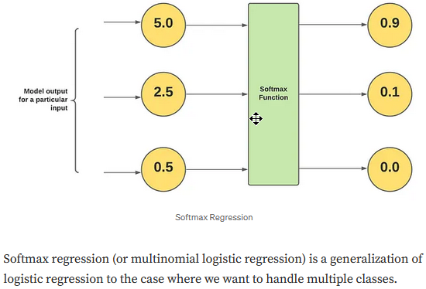

Slide 21
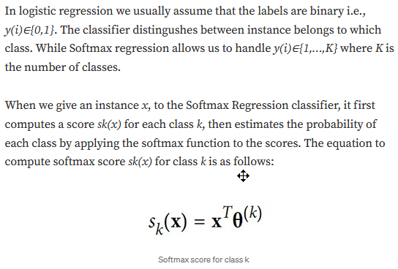

Slide 22
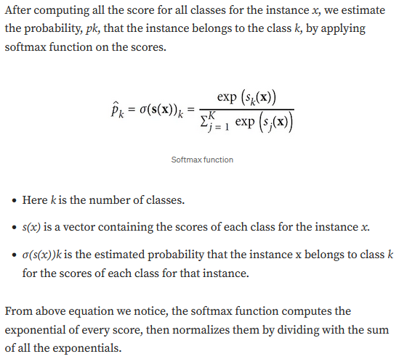

Slide 23
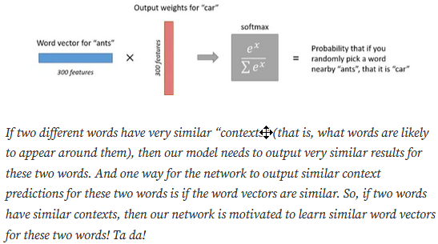
illustration of calculating the output of the output neuron for the word ‘car’

Slide 24
Each dimension of the input
Each dimension of the input passes through each node of the hidden layer.
The dimension is multiplied by the weight leading it to the hidden layer.
Because the input is a hot vector, only one of the input nodes will have a non-zero value (namely the value of 1).
This means that for a word only the weights associated with the input node with value 1 will be activated, as shown in the image in the previous slide.
As the input in this case is a hot vector, only one of the input nodes will have a non-zero value.
This means that only the weights connected to that input node will be activated in the hidden nodes.

Slide 25
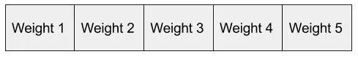
Example:
An example of the weights that will be considered is depicted below for the second word in the vocabulary:
The vector representation of the second word in the vocabulary (shown in the neural network before) will look as follows, once activated in the hidden layer:

Slide 26
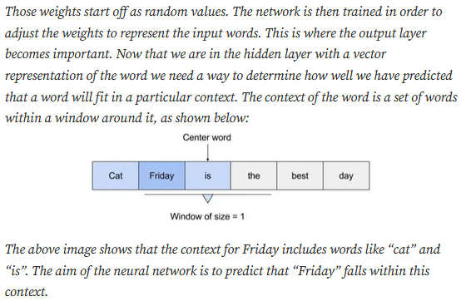

Slide 27
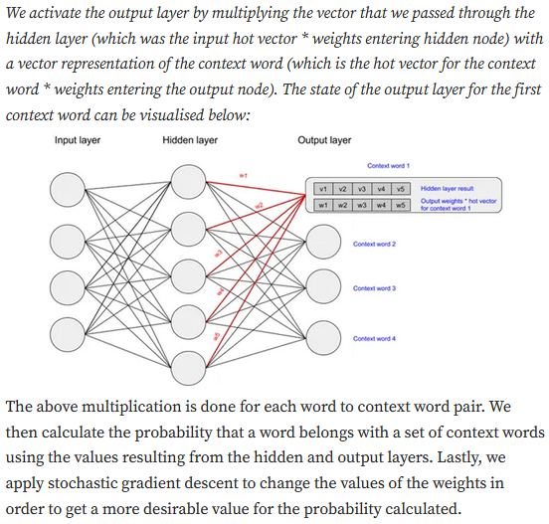

Slide 28
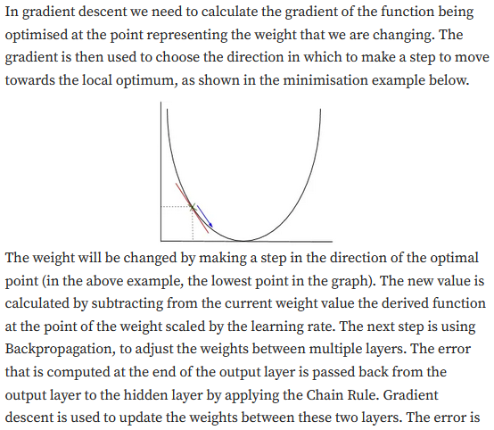

Slide 29
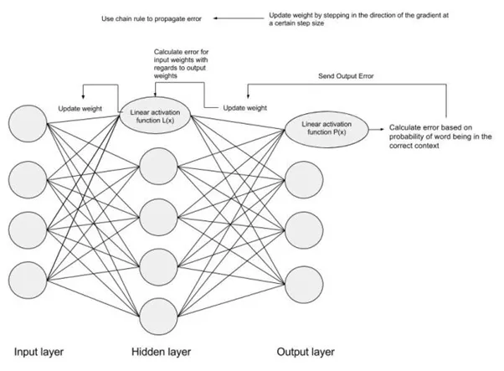
The error is then adjusted at each layer & sent back further using Backpropagation

Slide 30
Word2vec uses a single hidden layer
Word2vec uses a single hidden layer, fully connected neural network,
The neurons in the hidden layer are all linear neurons.
The input layer is set to have as many neurons as there are words in the vocabulary for training.
The hidden layer size is set to the dimensionality of the resulting word vectors.
The size of the output layer is same as the input layer.
Thus, if the vocabulary for learning word vectors consists of V words and N to be the dimension of word vectors, the input to hidden layer connections can be represented by matrix WI of size VxN with each row representing a vocabulary word.
In same way, the connections from hidden layer to output layer can be described by matrix WO of size NxV.
In this case, each column of WO matrix represents a word from the given vocabulary.

Slide 31
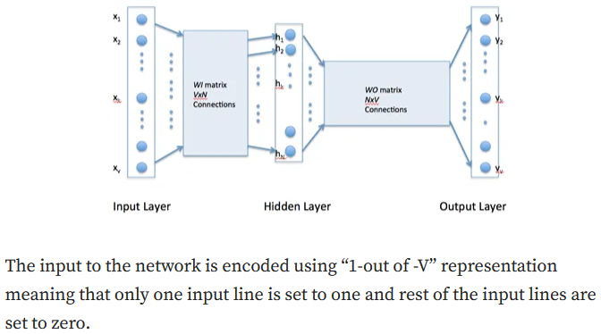

Slide 32
Example:
Let suppose we have a training corpus having the following sentences:
“the dog saw a cat”, “the dog chased the cat”, “the cat climbed a tree”
The corpus vocabulary has eight words.
Once ordered alphabetically, each word can be referenced by its index.
For this example, our neural network will have eight input neurons and eight output neurons.
Let us assume that we decide to use three neurons in the hidden layer.
This means that WI and WO will be 8×3 and 3×8 matrices, respectively.
Before training begins, these matrices are initialized to small random values as is usual in neural network training.

Slide 33
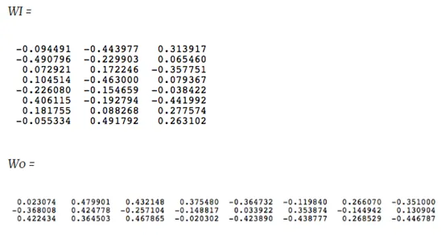
For the illustration sake, let us assume WI and WO to be initialized to the following values

Slide 34
Suppose we want the network to learn relationship between the words “cat” and “climbed”
That is, the network should show a high probability for “climbed” when “cat” is inputted to the network.
In word embedding terminology, the word “cat” is referred as the context word and the word “climbed” is referred as the target word.
In this case, the input vector X will be [0 1 0 0 0 0 0 0]. Notice that only the second component of the vector is 1.
This is because the input word is “cat” which is holding number two position in sorted list of corpus words.
Given that the target word is “climbed”, the target vector will look like
[0 0 0 1 0 0 0 0 ].
With the input vector representing “cat”, the output at the hidden layer neurons can be computed as:
Ht = XtWI = [-0.490796 -0.229903 0.065460]
It should not surprise us that the vector H of hidden neuron outputs mimics the weights of the second row of WI matrix because of 1-out-of-V representation.
So the function of the input to hidden layer connections is basically to copy the input word vector to hidden layer.

Slide 35
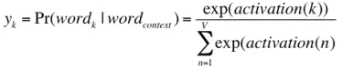
The activation vector for output layer neurons
Carrying out similar manipulations for hidden to output layer, the activation vector for output layer neurons can be written as
HtWO = [0.100934 -0.309331 -0.122361 -0.151399 0.143463 -0.051262 -0.079686 0.112928]
Since, the goal is produce probabilities for words in the output layer, Pr(wordk|wordcontext) for k = 1, V
to reflect their next word relationship with the context word at input, we need the
sum of neuron outputs in the output layer to add to one.
Word2vec achieves this by converting activation values of output layer neurons to probabilities using the softmax function.
Thus, the output of the k-th neuron is computed by the following expression where activation(n) represents the activation value of the n-th output layer neuron:

Slide 36
Probabilities
Thus, the probabilities for eight words in the corpus are:
0.143073 0.094925 0.114441 0.111166 0.149289 0.122874 0.119431 0.144800
The probability in bold is for the chosen target word “climbed”.
Given the target vector [0 0 0 1 0 0 0 0 ]t, the error vector for the output layer is easily computed by subtracting the probability vector from the target vector.
Once the error is known, the weights in the matrices WO and WI can be updated using backpropagation.
Thus, the training can proceed by presenting different context-target words pair from the corpus.
This is how Word2vec learns relationships between words and in the process develops vector representations for words in the corpus.

Slide 37
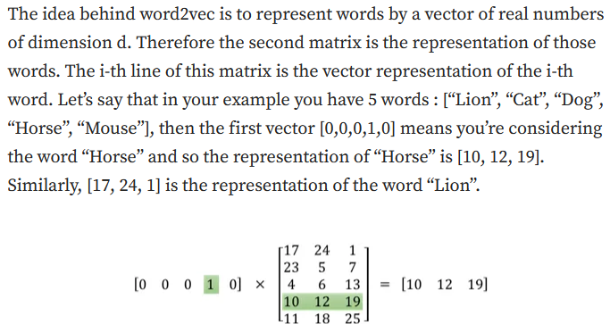

Slide 38
Human meaning
To our knowledge, there are no “human meaning” specifically to each of the numbers in these representations.
One number is not representing if the word is a verb or not, an adjective or not.
It’s just the weights that you change to solve your optimization problem to learn the representation of your words.

Slide 39
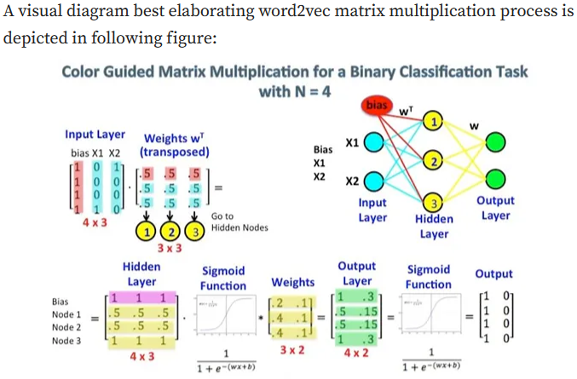

Slide 40
Hot Format
The first matrix represents the input vector in one hot format.
The second matrix represents the synaptic weights from the input layer neurons to the hidden layer neurons.
Especially notice the left top corner where the Input Layer matrix is multiplied with the Weight matrix.
Now look at the top right. This matrix multiplication InputLayer dot-producted with Weights Transpose is just a handy way to represent the neural network at the top right.

Slide 41
Weight Matrix
The first part, [0 0 0 1 0 … 0] represents the input word as a one hot vector and the other matrix represents the weight for the connection of each of the input layer neurons to the hidden layer neurons.
As Word2Vec trains, it backpropagates (using gradient descent) into these weights and changes them to give better representations of words as vectors.
Once training is accomplished, you use only this weight matrix, take
[0 0 1 0 0 … 0]
for say ‘dog’ and multiply it with the improved weight matrix to get the vector representation of ‘dog’ in a dimension = no of hidden layer neurons.
In the diagram, the number of hidden layer neurons is 3.

Slide 42
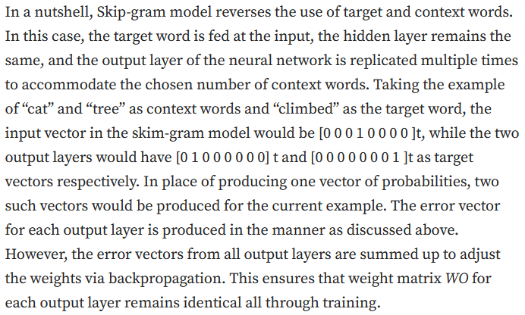

Slide 43
Modification
We need few additional modifications to the basic skip-gram model which are important for making it feasible to train.
Running gradient descent on a neural network that large is going to be slow.
And to make matters worse, you need a huge amount of training data to tune that many weights and avoid over-fitting.
Millions of weights times billions of training samples means that training this model is going to be a beast.
For that, authors have proposed two techniques called subsampling and negative sampling in which insignificant words are removed and only a specific sample of weights are updated.

Slide 44
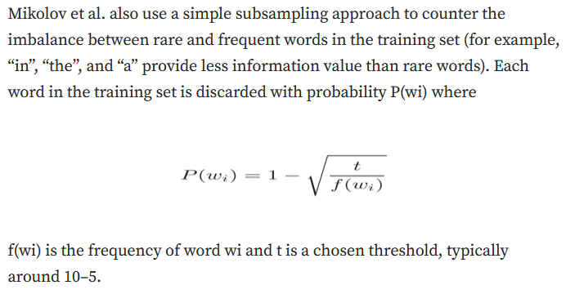

Slide 45
Implementation details
Word2vec has been implemented in various languages but here we will focus especially on Java i.e., DeepLearning4j, darks-learning, and python.
Various neural net algorithms have been implemented in DL4j, code is available on GitHub.

Slide 46
To implement it in DL4j
To implement it in DL4j, we will go through few steps given as following:
a) Word2Vec Setup
b) Load data
c) Tokenizing the Data
d) Training the Model
e) Evaluating the Model, Using Word2vec

Slide 47
a) Word2Vec Setup
Create a new project using Maven.
Then specify properties and dependencies in the POM.xml file in your project’s root directory.

Slide 48
b) Load data
Now create and name a new class in Java.
After that, you’ll take the raw sentences in your .txt file, traverse them with your iterator, and subject them to some sort of pre-processing, such as converting all words to lowercase.
String filePath = new ClassPathResource(“raw_sentences.txt”).getFile().getAbsolutePath();
log.info(“Load & Vectorize Sentences….”);
// Strip white space before and after for each line
SentenceIterator iter = new BasicLineIterator(filePath);

Slide 49
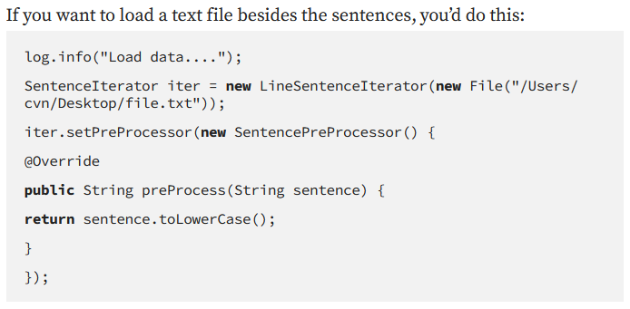

Slide 50
c) Tokenizing the Data
Word2vec needs to be fed words rather than whole sentences, so the next step is to tokenize the data.
To tokenize a text is to break it up into its atomic units, creating a new token each time you hit a white space, for example.
// Split on white spaces in the line to get words
TokenizerFactory t = new DefaultTokenizerFactory();
t.setTokenPreProcessor(new CommonPreprocessor());

Slide 51
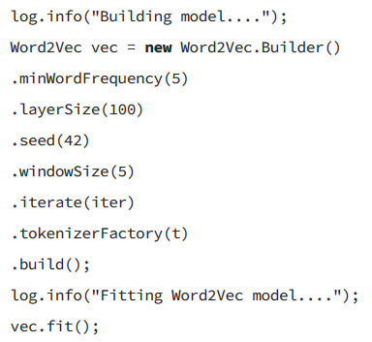
d) Training the Model
Now that the data is ready, you can configure the Word2vec neural net and feed in the tokens.

Slide 52
Configuration Parameters
batchSize is the amount of words you process at a time.
minWordFrequency is the minimum number of times a word must appear in the corpus. Here, if it appears less than 5 times, it is not learned. Words must appear in multiple contexts to learn useful features about them. In very large corpora, it’s reasonable to raise the minimum.
useAdaGrad — Adagrad creates a different gradient for each feature. Here we are not concerned with that.
layerSize specifies the number of features in the word vector. This is equal to the number of dimensions in the featurespace. Words represented by 500 features become points in a 500-dimensional space.
learningRate is the step size for each update of the coefficients, as words are repositioned in the feature space.
minLearningRate is the floor on the learning rate. Learning rate decays as the number of words you train on decreases. If learning rate shrinks too much, the net’s learning is no longer efficient. This keeps the coefficients moving.
iterate tells the net what batch of the dataset it’s training on.
tokenizer feeds it the words from the current batch.
vec.fit() tells the configured net to begin training.

Slide 53
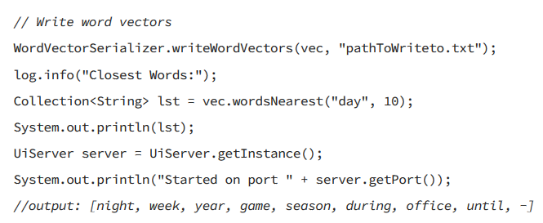
e) Evaluating the Model, Using Word2vec
The next step is to evaluate the quality of your feature vectors.

Slide 54
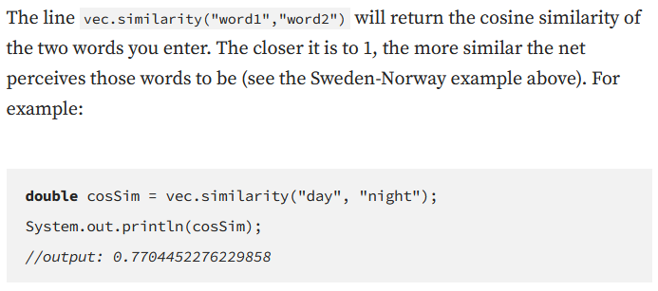

Slide 55
